Slide 1
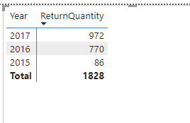
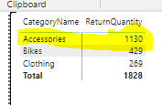
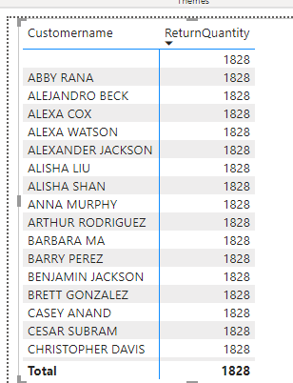
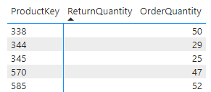
3.1) which category high volume of Return
3.2) Return order year wise
Product 338 is showing 50 ORDs
3.3) there is no relationship between customer and return lookup

Slide 2
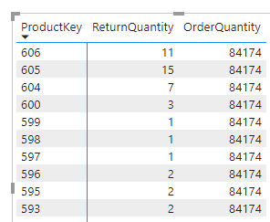
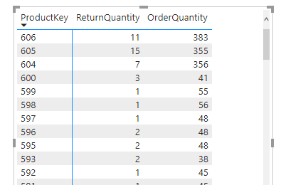
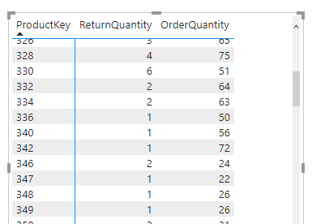
4.1) we have chose product key from returns and its don’t have relationship with order quantity (One way relationship – up to down)
4.2) two way relationship
4.3) ORDER 338 is not available in return that’s why its not available as we are using product key from return table not from product table where all product keys are available.

Slide 3
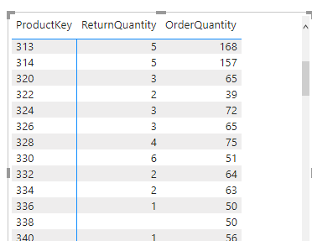
Relationship returned to single and hided the product key from return and order quantity
Using product key from product

